Slide 1
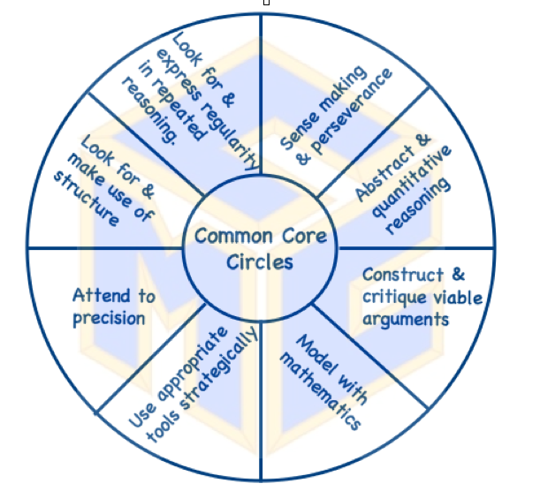
Common Core Circles: Part I How to Choose a Task
Developed by the CMC-S
CaCCSSM Committee
Notes:
Diane
Introduce Dina and Annette 1 min
Dina Williams – elementary math coordinator in LAUSD
Annette Kitagawa – admin with Riverside County Office of Education
Both are actively involved with CMC through the conference committee
2 minutes

Slide 2
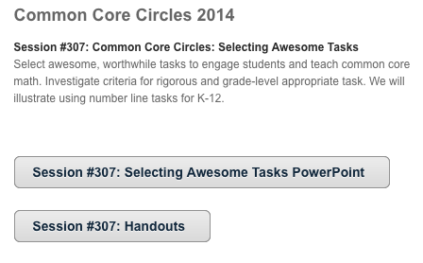
Common Core Circles: Part I How to Choose a Task
The handouts and PowerPoint are available on our webpage:
www.cmc-south.org/common-core-circles.html
Notes:
Diane
Introduce Dina and Annette 1 min
Dina Williams – elementary math coordinator in LAUSD
Annette Kitagawa – admin with Riverside County Office of Education
Both are actively involved with CMC through the conference committee
2 minutes

Slide 3
Outcomes
Participants will
Learn how to choose appropriate math tasks to use with their students
Learn how to choose tasks that facilitate student thinking around common core mathematics standards.
Learn how to implement such tasks within their classrooms.
Receive information on submitting anonymous student work to be part of our study of this and other tasks.
Notes:
Diane 1 min.

Slide 4
What is a Common Core Math Circle?
Inspired by Math Circles
Student Math Circles
A social context for students to explore math
Teacher Math Circles
A social context for teachers to explore math and its pedagogy.
Common Core Math Circles
A social context for teachers to explore Common Core Math Standards and related pedagogy.
http://www.mathteacherscircle.org/news.html
Notes:
Diane 3 min

Slide 5
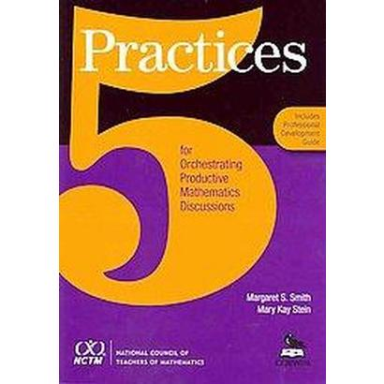
Math Circles Part II
Part I
5 Practices
5 Practices for Orchestrating Productive Mathematics Discussions:
Anticipating
Monitoring
Selecting
Sequencing
Connecting
Notes:
Diane

Slide 6
Performing the Task
By Grade Level:
Grades K - 2 Whole Number task
Grade 3 - 5: Fraction Task
Grade 6 & 7:
Decimal Task or
Integer Task
Grade 8 & High School: Real Number/Algebra Task
Notes:
Annette 3 min
The slide lists tasks for all grade levels. Today as a group we will do the fraction task.
With the common core standards, a common tool throughout the grade levels is the use of the number line. We will provide a number line task for the different grade spans.
Today we will focus on the fraction number line as a means of discussion.

Slide 7
Labeling Numbers on the Number Line: Fractions
Instructions:
Solve the task as an adult learner.
In your group, choose the task that you found to be the most challenging and the task that you found to be the easiest.
Prepare a rationale for your rating.
Notes:
Dina 3 min.
How many they rank will depend on time. They should at least choose the hardest and the easiest and have a reason for these rankings.
On your table, please find the fraction number line task. There should be one for each of you. Please take a couple of minutes to find the solutions to the number lines. As you are solving the tasks, decide which ones are the easiest to solve and which ones will be more challenging to solve. When you finish, decide which ONE was the easiest and which was the hardest to solve. Remember you are solving these as an adult learner.
I’ll check In with you in about 10 min
Dina, Annette and Diane will be circulating around the room to ask questions and facilitate conversations.

Slide 8
Notes:
Dina
20 min.

Slide 9
Share Solutions
Come to consensus in your group of your choices of the least and most challenging problems.
Be prepared to share your reasoning and justifications with the whole group.
Notes:
10 min
Dina
How did you determine the length of each interval on each number line?
Recommend that with students, written justifications should be given.

Slide 10
Making Connections
At your table, Reflect on the task:
What were similarities and differences in approaches to this task?
What mathematics were you engaged in while you worked on this task?
Was there any selection of least and most challenging that surprised you?
What did you learn from the discussion?
How might your experience today influence your pedagogy?
Notes:
Possible questions if not already addressed:
How did you determine the length of each interval on each number line?
Dina 10 min
Address questions that did not come up through process.

Slide 11
Copies of the Task at all grade levels
By Grade Level:
Grades K - 2 Whole Number task
Grade 3 - 5: Fraction Task
Grade 6 & 7:
Decimal Task or
Integer Task
Grade 8 & High School: Real Number/Algebra Task
Notes:
Slides 9 – 14 15 min.
Annette
The slide lists tasks for all grade levels. Today as a group we will do the fraction task.

Slide 12
The Mathematics of the Task
What domain or conceptual category is targeted by this task?
What content standards?
What standards for mathematical practice
What assessment claims are targeted?
Next slide
What Depth of Knowledge Level?
Next slides
Notes:
Annette
Handout

Slide 13
The Mathematics of the Task
What assessment claims are targeted?
Primary Claim 3: Communicating Reason: Students can clearly and precisely construct viable arguments to support their own reasoning and to critique the reasoning of other.
Secondary Claim 1: Concepts and Procedures: Students can explain and apply mathematical concepts and interpret and carry out mathematical procedures with precision and fluency.
Other Claims include:
Claim 2: Problem Solving
Claim 4: Modeling and Data Analysis
Notes:
Annette
Recall there are 4 claims with all the tasks that SBAC.

Slide 14
The Mathematics of the Task
What Depth of Knowledge Level?
If enacted at highest level: DOK Level 3: Strategic Thinking
If enacted at a lower level: DOK Level 2: Skills and Concepts
Other Levels include:
Level 1: Recall
Level 4: Extended Thinking
Notes:
Annette
Reflect back to the questions Dina and others asked while sharing out the thinking on the problems.

Slide 15
Task Evaluation
What follows is a list of criteria for worthwhile tasks. The first 4 criteria are essential for every task. The others are recommended, but may not be possible in every situation.
Notes:
Diane slides 15 – 18 (10 min.)
Emphasize connection to the number line task.

Slide 16
Essential Criteria
The task:
Is built around Important, useful mathematics
Requires higher-level thinking and problem solving
Contributes to the conceptual development of students’ thinking.
Provides formative assessment opportunities
Did the number line task meet these characteristics? How?
Notes:
Diane

Slide 17
Additional Criteria
The Task:
Allows for multiple entry points and solution strategies
Allows for multiple claims for which evidence can be provided
Encourages student engagement and discourse
Connects to other important mathematical ideas and/or ideas in other disciplines
Did the number line task meet these characteristics? How?
Notes:
Diane

Slide 18
Additional Criteria
The Task:
Promotes the skillful use of mathematics
Provides an opportunity to practice important skills
Displays sensitivity to and draws on students’ diverse background experiences & dispositions
Promotes the development of all students’ disposition to do mathematics
Did the number line task meet these characteristics? How?
Notes:
Diane

Slide 19
Choosing a Worthwhile Task
Of the three tasks listed below, which one is the most worthwhile? Why?
To multiply or not to multiply?
Running to School
Making Cookies
Discussion
Notes:
Dina and Annette (15 min)
Handout
You are going to give you an opportunity to analyze 3 different task. Based on the criteria that we just shared and the document you have in front of you, which of these tasks best aligns with the criteria?
Running to school – no
To Multiply and Making cookies – yes

Slide 20
Resources for Tasks:
Illustrative Mathematics
For K-8:
http://www.illustrativemathematics.org/standards/k8
For 9-12
http://www.illustrativemathematics.org/standards/hs
For SMP
http://www.illustrativemathematics.org/standards/practice
Inside Mathematics (K-12)
http://www.insidemathematics.org/index.php/mathematical-content-standards
Notes:
1 min. Diane

Slide 21
Resources for Tasks
NCTM Illuminations (K-12)
http://illuminations.nctm.org/Lessons.aspx
Annenberg Learner
http://www.learner.org/resources/browse.html?discipline=5&grade=0
Thinkfinity (K-12)
http://www.thinkfinity.org/community/thinkfinity-resources
Questions?
CMC-S website
(http://www.cmc-south.org/common-core.html)
Diane Kinch at dokinch@gmail.com
Notes:
Diane 1 min

Slide 22
Strongly
Disagree
Strongly
Agree
Disagree
Agree
0 1 2 3
Send your text message to this Phone Number: 37607
5 digit
poll code
for this session
Speaker was engaging and an effective presenter (0-3)
Other comments, suggestions, or feedback (words)
___ ___ ___ ___________
_______
(1 space)
(1 space)
(no spaces)
Speaker was well-prepared and knowledgeable (0-3)
Session matched title and description in program book (0-3)
Example: 38102 323 Great session!
Non-Example: 38102 3 2 3 Great session!
Non-Example: 381023-2-3Great session!

Slide 23
Strongly
Disagree
Strongly
Agree
Disagree
Agree
The Poll Code for this session: 44379
0 1 2 3
Send your text message to this Phone Number: 37607
5 digit
poll code
for this session
Speaker was engaging and an effective presenter (0-3)
Other comments, suggestions, or feedback (words)
___ ___ ___ ___________
(1 space)
44379
_______
(1 space)
(no spaces)
Speaker was well-prepared and knowledgeable (0-3)
Session matched title and description in program book (0-3)
Example: XXXXX 323 Great session!
Non-Example: XXXXX 3 2 3 Great session!
Non-Example: XXXXX3-2-3Great session!

