Slide 1
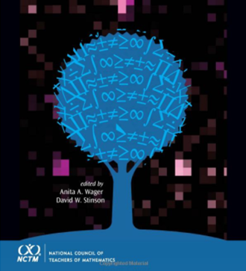
Teaching Mathematics for
Social Justice
Conversations with Educators
California Mathematics Council
South Section
@CAMathCouncil

Slide 2
Reflection
Questions
Teaching Mathematics for
Social Justice
Conversations with Educators
How might teachers begin to teach mathematics for social justice? How might teacher educators begin to teach teachers how to teach mathematics for social justice?
How might teaching mathematics for social justice "look like?"
How can mathematics be re-envisioned as a means to create a more socially just world?
Notes:
the purpose of this book is
to provide a historical perspective and theoretical grounding for critical mathematics in general and TMfSJ
(Because of time we are not going to go into the historical and theoretical perspective)
to demonstrate how TMfSJ might be integrated into preservice and in-service mathematics teacher education and professional development,
to demonstrate what TMfSJ might “look like” within mathematics classrooms

Slide 3
More than access to high-quality mathematics instruction
Equity
A way to address broader social, political and ideological issues in the classroom and our society.
Courtney Koestler, University of Arizona, Tucson, Arizona, Chapter 6 p.83

Slide 4
Respecting Students Knowledge
Marilyn Frankenstein, University of Massachusetts Boston, Boston Massachusetts Chapter 4 p.51

Slide 5
In a trade between an African sheepherder and an explorer…
A header agrees to accept two sticks of tobacco for one sheep. He becomes confused and angry when he is given four sticks of tobacco for two sheep.
Conclusion?
The sheepherder could not comprehend 2+2=4.
Marilyn Frankenstein, University of Massachusetts Boston, Boston Massachusetts Chapter 4 p.52

Slide 6
In a trade between an African sheepherder and an explorer…
A conclusion that respects the sheepherders knowledge?
Given that the sheep are not standardized units it is logical that a second sheep would not also be worth two sticks of tobacco.
Marilyn Frankenstein, University of Massachusetts Boston, Boston Massachusetts Chapter 4 p.52

Slide 7
Assets-Based Approach
Develops and maintains students identities
Cultural
Social
Academic
Recognizing and valuing the knowledge that students bring.
Courtney Koestler, University of Arizona, Tucson, Arizona, Chapter 6 p.83

Slide 8
Valuing intellectual diversity means that we should rethink the concepts of “remedial education,” “underprepared student,” and the like.
Marilyn Frankenstein, University of Massachusetts Boston, Boston Massachusetts Chapter 4 p.52

Slide 9
Teaching Mathematics for Social Justice TMfSJ

Slide 10
Consider equitable and socially just mathematics teaching and learning, with attention to classical, community, and critical mathematical knowledge
Gutstein’s 3C Framework
Courtney Koestler, University of Arizona, Tucson, Arizona, Chapter 6 p.86

Slide 11
the learning of “school mathematics” content with understanding
Classical
Mathematics Knowledge
Courtney Koestler, University of Arizona, Tucson, Arizona, Chapter 6 p.86

Slide 12
the mathematics people gain and use in their out-of-school lives
Community Mathematics Knowledge
Courtney Koestler, University of Arizona, Tucson, Arizona, Chapter 6 p.86

Slide 13
the mathematics necessary to understand, analyze, address, and critique issues of social (in)justice
Critical
Mathematics Knowledge
Courtney Koestler, University of Arizona, Tucson, Arizona, Chapter 6 p.86

Slide 14
Resist the False Dichotomy
Real vs Ancillary
Courtney Koestler, University of Arizona, Tucson, Arizona, Chapter 6 p.87

Slide 15
Guiding Principles
Doing mathematics is a sense-making activity
All peoples can and do engage in mathematics
Students bring valuable knowledge to school
Mathematics teaching is political
Continual and critical reflection is necessary to understand context
Be critical consumers of scholarly knowledge
Adapted Courtney Koestler, University of Arizona, Tucson, Arizona, Chapter 6 p.89, 90

Slide 16
Guiding Principle 1
Doing mathematics is a sense-making activity
Courtney Koestler, University of Arizona, Tucson, Arizona, Chapter 6 p.89

Slide 17
Guiding Principle 2
All peoples can and do engage in mathematics
Courtney Koestler, University of Arizona, Tucson, Arizona, Chapter 6 p.89

Slide 18
Guiding Principle 3
Students bring valuable knowledge to school
Courtney Koestler, University of Arizona, Tucson, Arizona, Chapter 6 p.90

Slide 19
Guiding Principle 4
Mathematics teaching is political
Courtney Koestler, University of Arizona, Tucson, Arizona, Chapter 6 p.90

Slide 20
Guiding Principle 5
Continual and critical reflection is necessary to understand context
Courtney Koestler, University of Arizona, Tucson, Arizona, Chapter 6 p.90

Slide 21
Guiding Principle 6
Be critical consumers of scholarly knowledge
Courtney Koestler, University of Arizona, Tucson, Arizona, Chapter 6 p.90

Slide 22
Transformative Pedagogy in Teacher Education
Transforming mathematics teachers’ beliefs and dispositions needs to begin with transforming teacher educators’ actions in colleges and schools of education.
Jacqueline Leonard, University of Colorado Denver, Denver Colorado
Brian R. Evans, Pace University, New York New York, Chapter 7 p.103

Slide 23
Transformative Pedagogy in Teacher Education
Research has demonstrated that preservice teachers more readily take up beliefs, attitudes, actions, and pedagogies that embrace an equity and social justice perspective if these perspectives are a consistent theme across all or most of the courses in their teacher education program.
Courtney Koestler, University of Arizona, Tucson, Arizona, Chapter 6 p.90

Slide 24
How do you start TMfSJ?
It takes time
Be patient with yourself
Be aware that students will think it strange to be asked to use mathematics to study their own lives
Eric (Rico) Gutstein, University of Illinois at Chicago, Chicago Illinois, Chapter 5 p. 66

Slide 25
How do you create classrooms that engage students in critical mathematics?
Eric (Rico) Gutstein, University of Illinois at Chicago, Chicago Illinois, Chapter 5 p. 66

Slide 26
Where do you get these projects and units?
Eric (Rico) Gutstein, University of Illinois at Chicago, Chicago Illinois, Chapter 5 p. 67

Slide 27
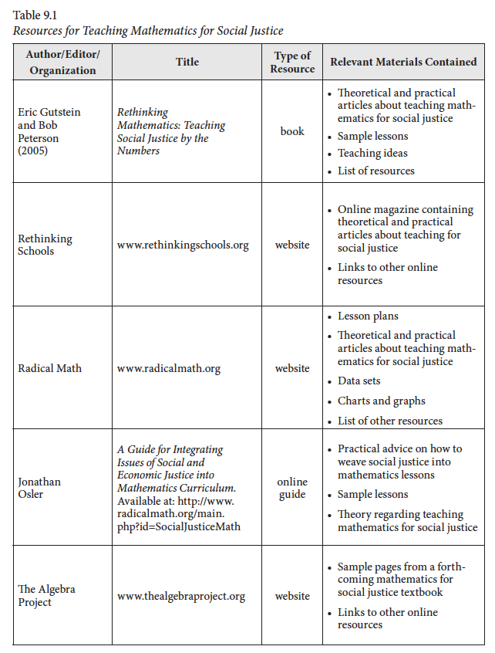
Lidia Gonzalez, City University of New York – York College, New York, New York, Chapter 9 p.130

Slide 28
So how do you get students to talk seriously about their lives? Why should they trust you/me especially if you’re not from their community?
Eric (Rico) Gutstein, University of Illinois at Chicago, Chicago Illinois, Chapter 5 p. 68

Slide 29
“These political relationships include taking active political stands in solidarity with students and their communities about issues that matter. Political relationships also entail teachers sharing political analyses with students as much as possible. Finally, they include talking with students about social movements, involving students themselves in studying injustice, and providing opportunities for them to join in struggles to change the unjust conditions.
Eric (Rico) Gutstein, University of Illinois at Chicago, Chicago Illinois, Chapter 5 p. 68

Slide 30
Develop Political Relationships? Are you propagandizing young people? Overly politicizing teaching? Imposing your political views?
Eric (Rico) Gutstein, University of Illinois at Chicago, Chicago Illinois, Chapter 5 p. 68-70

Slide 31
“It is impossible to live, let alone exist, without risks.” - Paulo Freire’s
Eric (Rico) Gutstein, University of Illinois at Chicago, Chicago Illinois, Chapter 5 p.70

Slide 32
Teach students to NOT accept our views without questioning nor to accept surface-level explanations of complicated issues.
Eric (Rico) Gutstein, University of Illinois at Chicago, Chicago Illinois, Chapter 5 p.70

Slide 33
“The best way to accomplish those things that are impossible today is to do today whatever is possible”
– Paulo Freire
Eric (Rico) Gutstein, University of Illinois at Chicago, Chicago Illinois, Chapter 5 p.76

Slide 34
“A new world order is urgently needed. Our hopes for the future depend on learning—critically—the lessons of the past. We must assume a transdisciplinarian posture, and we need to look at all development and modes of understanding in different cultural environments, in different traditions—that is, we must assume a transcultural posture. This new posture may restore to mathematics its characteristic of being the most universal mode of thought and may allow it to face the most universal problem facing humanity, which is survival with dignity.
Ubiratan D’Ambrosio, State University of Campinas, São Paulo, Brazil (Emeritus), Chapter 14 p. 210

Slide 35
Reflection
Questions
Teaching Mathematics for
Social Justice
Conversations with Educators
How might teachers begin to teach mathematics for social justice? How might teacher educators begin to teach teachers how to teach mathematics for social justice?
How might teaching mathematics for social justice "look like?"
How can mathematics be re-envisioned as a means to create a more socially just world?
Notes:
the purpose of this book is
to provide a historical perspective and theoretical grounding for critical mathematics in general and TMfSJ
(Because of time we are not going to go into the historical and theoretical perspective)
to demonstrate how TMfSJ might be integrated into preservice and in-service mathematics teacher education and professional development,
to demonstrate what TMfSJ might “look like” within mathematics classrooms

Slide 36
California Mathematics Council
South Section
@CAMathCouncil
Teaching Mathematics for
Social Justice
Conversations with Educators
Diana Ceja
Immediate Past President
@imathination
Rosa Serratore
President
@serratore4
Christina Moore
Equity Committee Chairperson
@Virtuouscm
#mathequity. #EQSJmath

